Slide 1
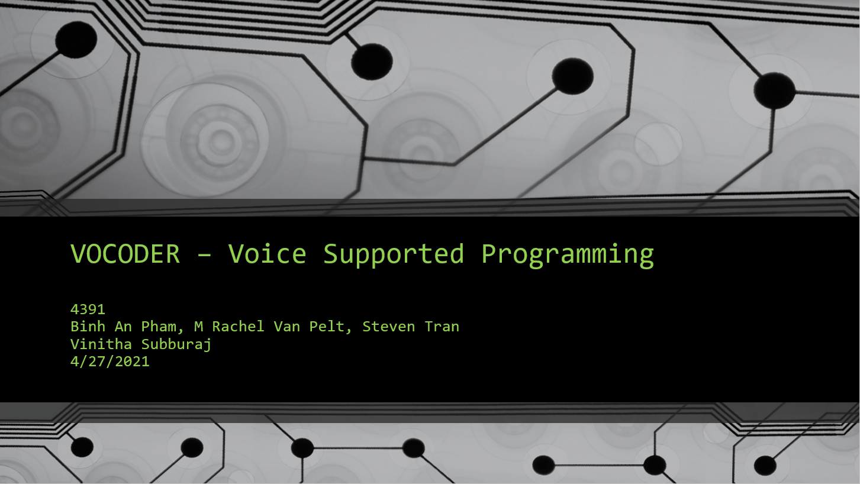

Slide 2

Introduction
Problem Statement
Carpal tunnel syndrome (CTS) and tendonitis are conditions that all programmers are susceptible to if they don’t take the necessary precautions against it. This problem could be alleviated by having the programmer being able to code simple statements without use of their hands, reducing the risk of developing CTS. “Support for programming by voice has the potential to increase the productivity of developers afflicted by these problems. In addition, it can enable individuals with upper-body motor impairments to write code. In this project, we explore the development of a prototype system to support programming by voice.”(1)
Alleviate CTS by hands-free coding
Procedural programs in Python
Improve existing solutions
Notes:
As a software developer, we are expected to spend a significant amount of time typing on a keyboard to write code. Doing this long enough can lead to problems with some people developing repetitive strain injuries such as carpal tunnel syndrome and tendonitis which will severely impact a software developer for life. To address this issue, we have decided to come up with an IDE that will be able to accept a user’s voice input and use that to help them with writing the code needed. There are also some people with upper-body motor impairments that this project could assist with writing code.

Slide 3
Requirements Phase
Functional Requirements:
MUST
SHOULD
COULD
receive input from the user using a Natural Language Interface
receive input from the user using a Menu Driven Interface
allow the user to create assignment, return, and conditional statements
allow the user to create a loop
be able to navigate through the program
handle creating arrays
receive input from the user using a Graphical User Interface
execute an undo command
execute a redo command
handle clipboard functions
Notes:
These are a list of functional requirements of what must, should, and could be on the IDE that we are creating. Some of these requirements were given by our sponsor, while the others were ones we thought would benefit the project.

Slide 4
Non-Functional Requirements:
Performance
Reliability
Availability
ready for editing in less than 10 seconds from startup
take less than 500ms to display the result from any voice commands
maintain an accuracy of at least 80% when responding to user’s voice commands
channel of communication to a voice input device
available for the user without requiring an internet connection to work
Security
Testability
Modifiability
system should not share or upload any recorded audio from the editing sessions
individual functions can be tested separately
Functions implemented without affecting the whole system
minimal duplication of code
Code will not be lacking in documentation
sufficient refactoring
Notes:
As an IDE, it should have enough functional features to make it worth using for the user. Something just as important is the ease of use and performance of the system.

Slide 5





Feasibility analysis: Technical
Hardware
Software
Programming and testing
Quality voice input
Low risk: can handle running the application and a text editor at the same time
open-source voice recognition software
environment to program the app
Translate voice input into text output, create GUI, accurately follow user’s commands
Notes:
As you can see here, the IDE doesn’t need much to make it work, just a working computer that can handle running the IDE and a microphone to take voice input.

Slide 6





Feasibility analysis: Non-Technical
Scheduling
Financial
finish all planning and design
Agile and Prototyping
open-source software
progress reports
Microphone
Open-source
Very low cost
Operational
Ethical & Social
learn a new set of commands
intuitive and easy to learn
meet the overall goal
not storing recorded voice inputs for text editor window
minimize the usage of the keyboard
Program useful commands

Slide 7
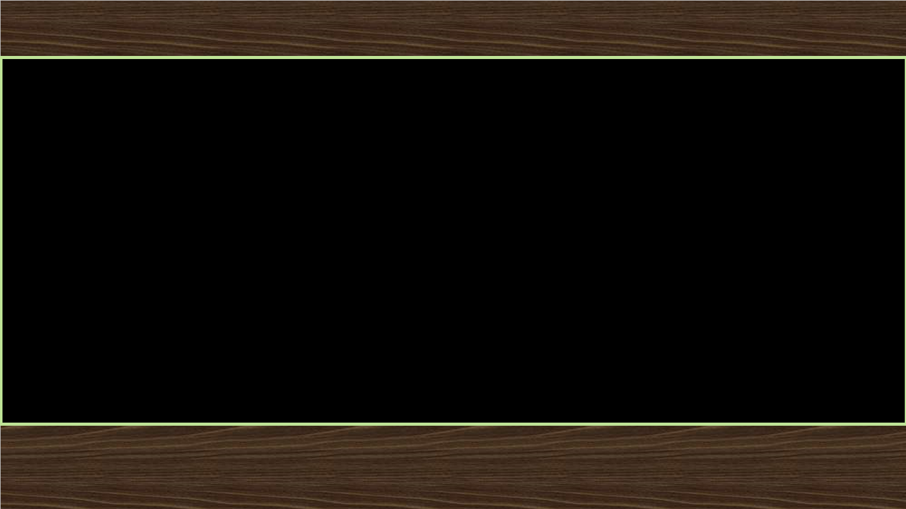
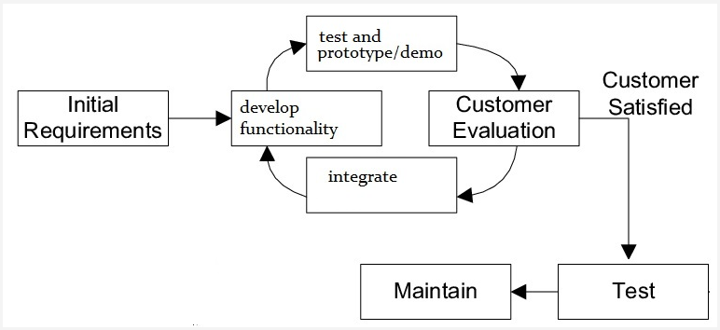
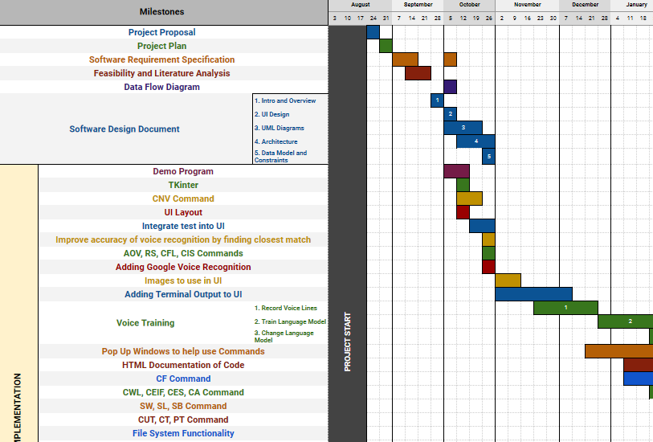
Project Management
Tools:
Discord
Google Drive/Docs
Email
Github and Visual Studio
Hybrid of Prototyping and Agile
Project Plan Template in Excel

Slide 8
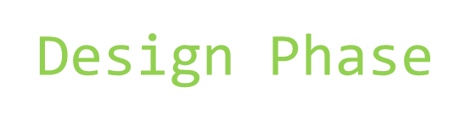
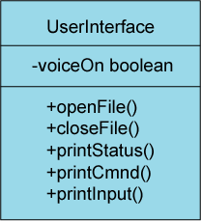
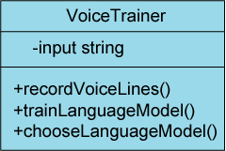
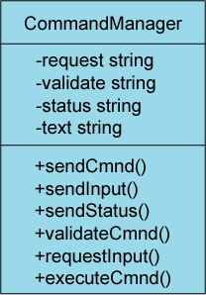
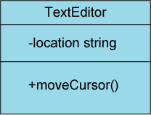
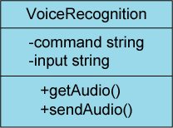
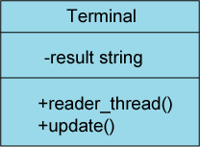
Class Diagram
Notes:
In the next few slides, you’ll see some diagrams for the design of this project

Slide 9
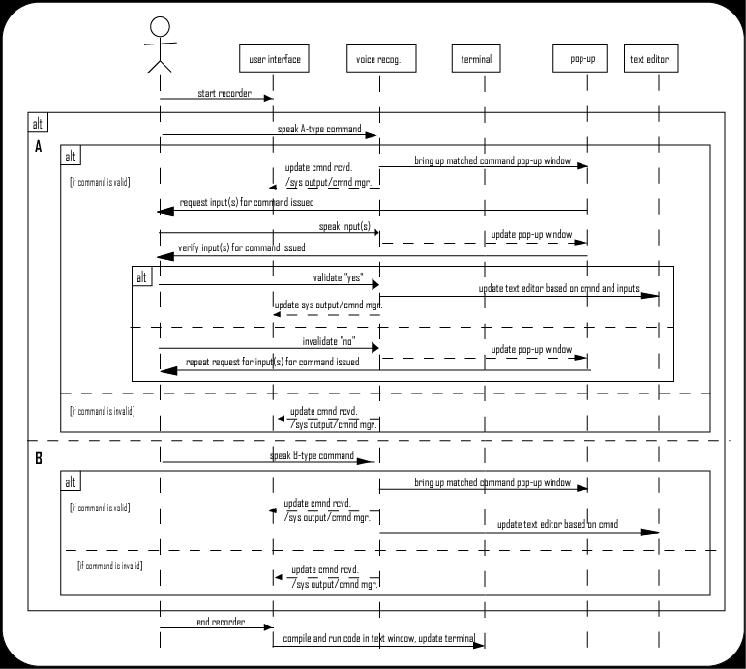
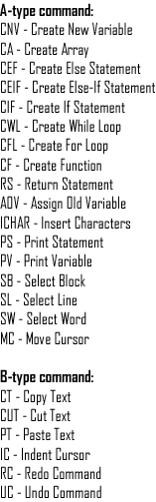
Sequence Diagram

Slide 10
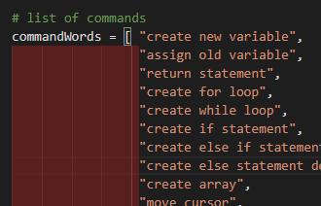


Design:
Constraints - Challenges - Process
No commercial tools or services required for the system to work
Pre-programmed commands for comparison
Open source voice recognition, such as CMU Sphinx
Machine learning to increase the accuracy

Slide 11
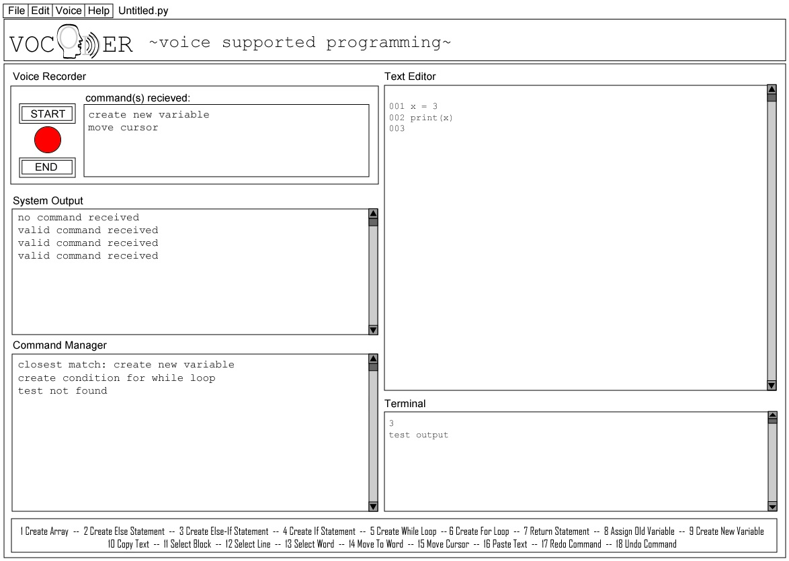
Design
User Interface
Notes:
In the next few slides, you’ll see some diagrams for the design of this project

Slide 12
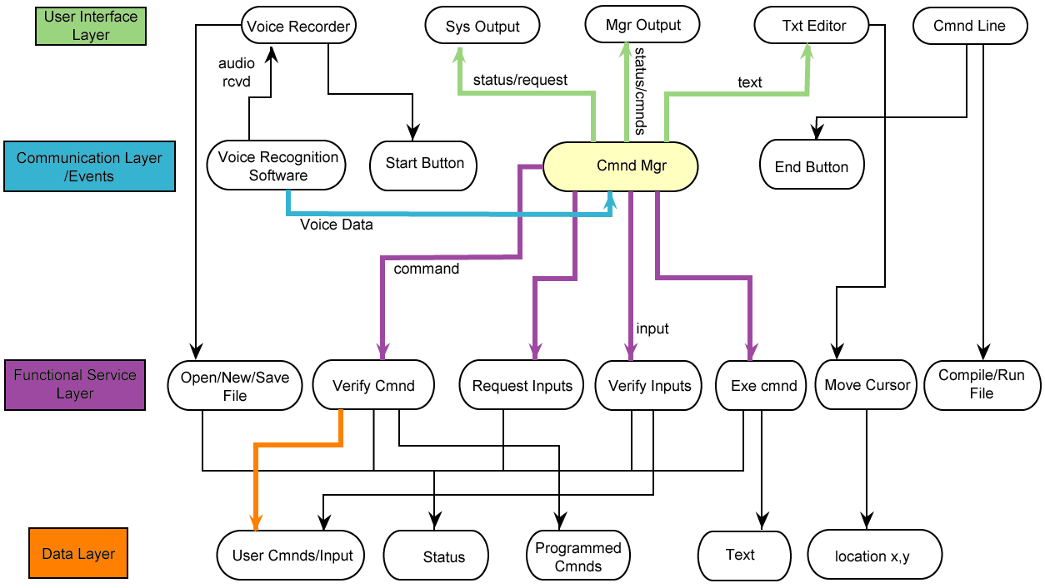
Process:
- combination of layered architecture and event- driven architecture
Architecture Diagram

Slide 13


Implementation
Critical functionalities - pseudo code
getVoiceInput(): r = speech recognizer while there is audio to use as input audio = formatted input audio audioToText = speech to text from audio using r return audioToText
phraseMatch(audioToText): closestString = command string best matched to audioToText
if closest string == “command 1” stringP = command1() elif closest string == “command 2” stringP = command2() …

Slide 14
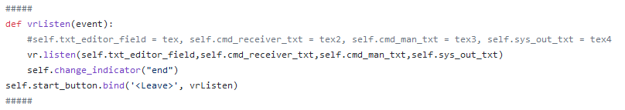
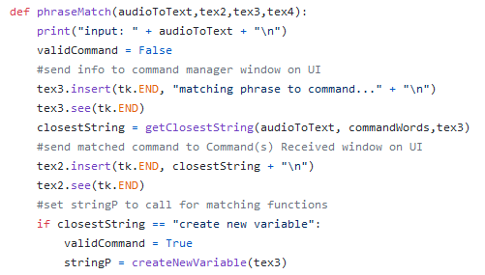
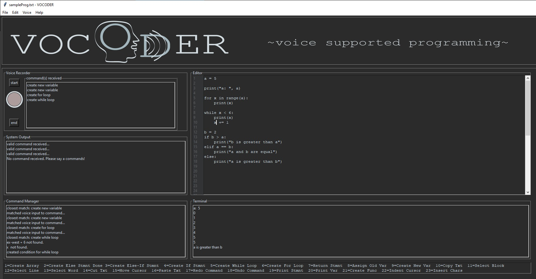
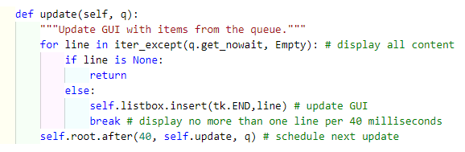
Implementation
Code Snippets
application.py
voice_recognition.py
compiler.py

Slide 15
Implementation
Status - Code Metrics
Completion of project:
User Interface 100%
Use cases implemented 100%
Voice Recognition Accuracy 84%
NLOC
Highest Complexity
Risk
Application.py
Voice_recognition.py
Compiler.py
Editor_module.py
Numberlines.py
507
704
59
115
61
changeLangMod()
phraseMatch()
readerThread()
saveFile()
reDraw()
Low
+Moderate
Low
Low
Low

Slide 16
Testing
Approach
Equivalence
Partition Technique
Design Document
Acceptance
Testing
Walk-Through
Sequence Diagram
Monitor UI visually for errors
Monitor UI visually for errors
Compare
system to initial requirements
Compare
document
to
system
Built correctly &
meets proposed need
Matches needs of intended user
Pass
Expected output

Slide 17
Testing
Report of Findings
Test Case
Input
Expected Output
Actual Output
Pass
getVoiceInput()
“Create new variable”
execute
createNewVariable()
execute
createNewVariable()
Pass
createNewVariable()
“a”, “1”
a = 1
a = 1
trainModelButton()
string: valid directory name, training model choice
Language model with input directory name is created using training model
Language model with input directory name is created using training model
Pass

Slide 18

Summary
Goals:
Help alleviate CTS
Improve upon current options
Milestones:
Meets all initial requirements
Stayed close to original design
Improved voice accuracy
Exhaustive Testing
Achievements:
User-friendly solution
Extra commands & functions beyond
original scope of the project
Future
Working executable
Expansion of command inputs
Address coding in other languages
Maintenance
HTML documentation
User Manual
Bug Reports via Github
“...voice will be a natural way for the new generation of users to interact with technology”
-www.smashingmagazine.com

Slide 19
DEMO

Slide 20
Our Take Away...
Thank You!
Q&A

